Slide 1
ST. JOSEPH HOSPITAL GALLERY 2022

Slide 2
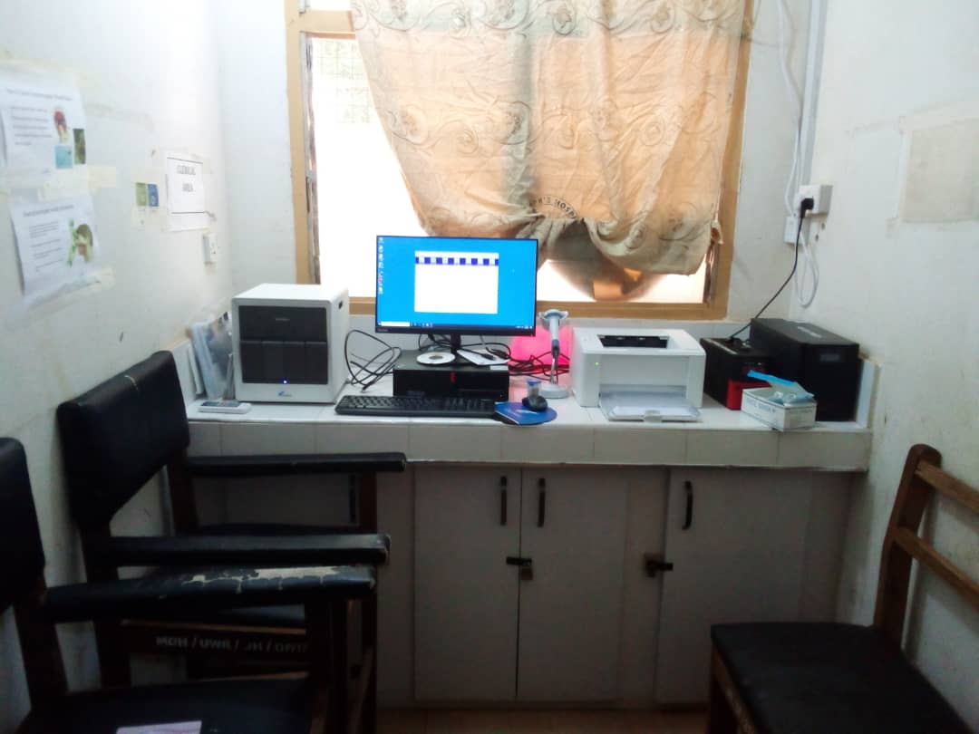
GENE X’PERT FOR PCR TESTS

Slide 3
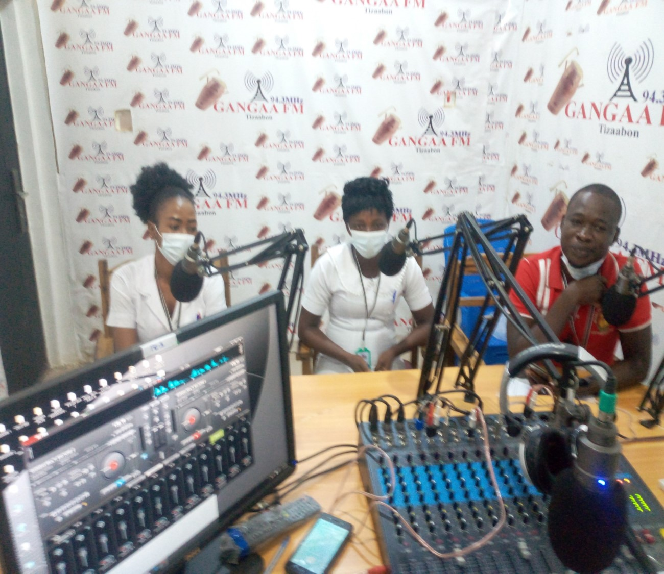
BIRTH PREPAREDNESS AND COMPLICATION READINESS

Slide 4
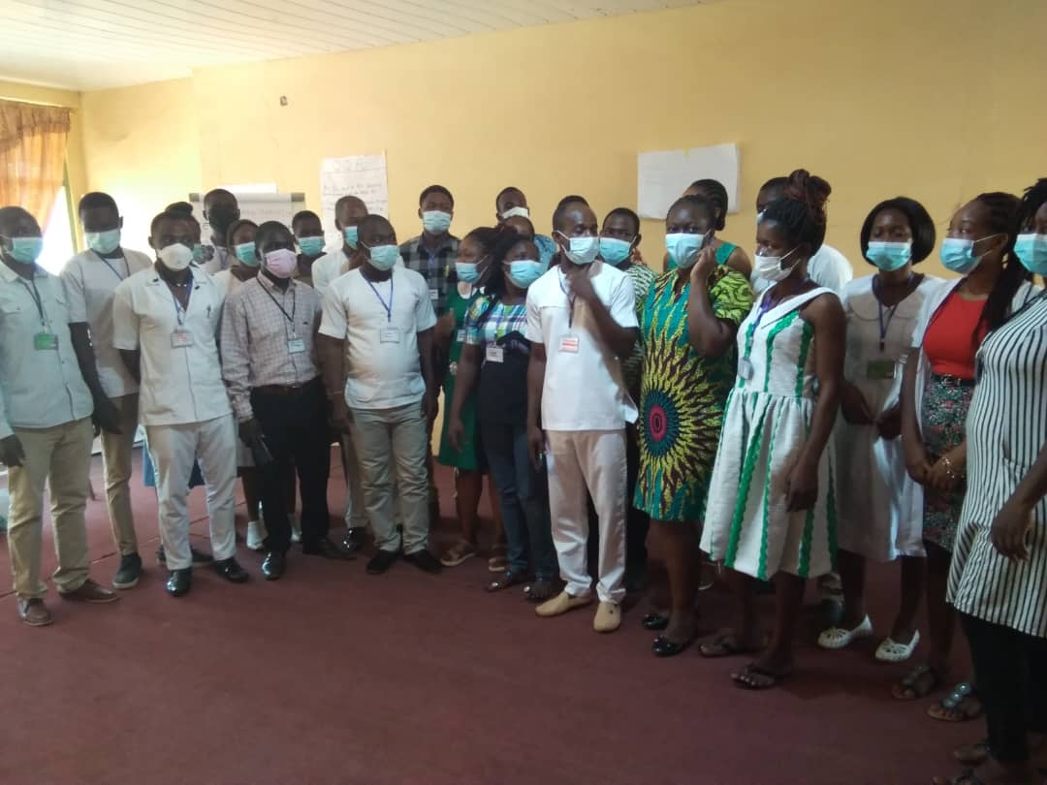
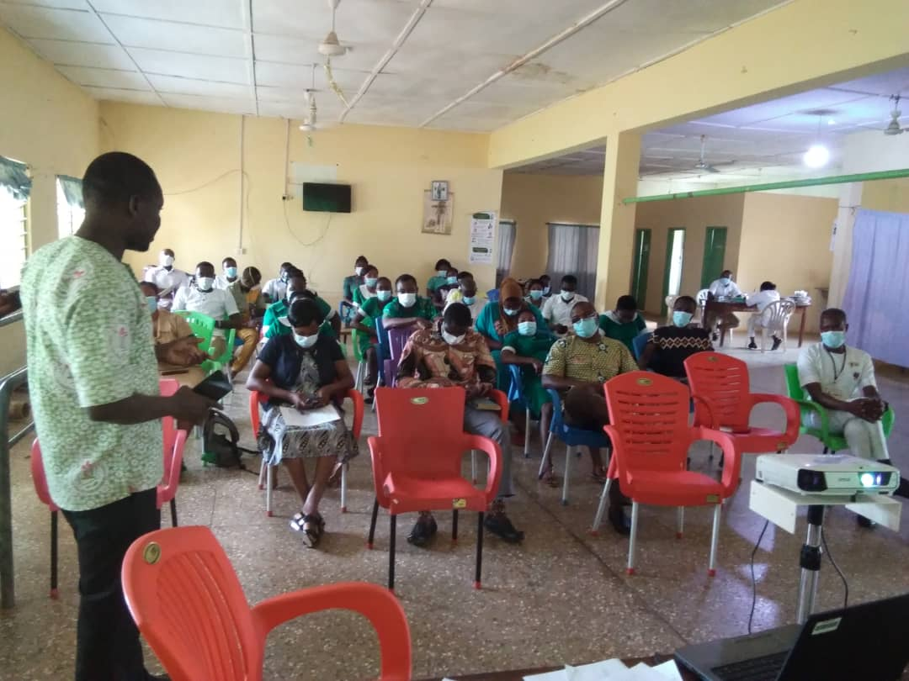
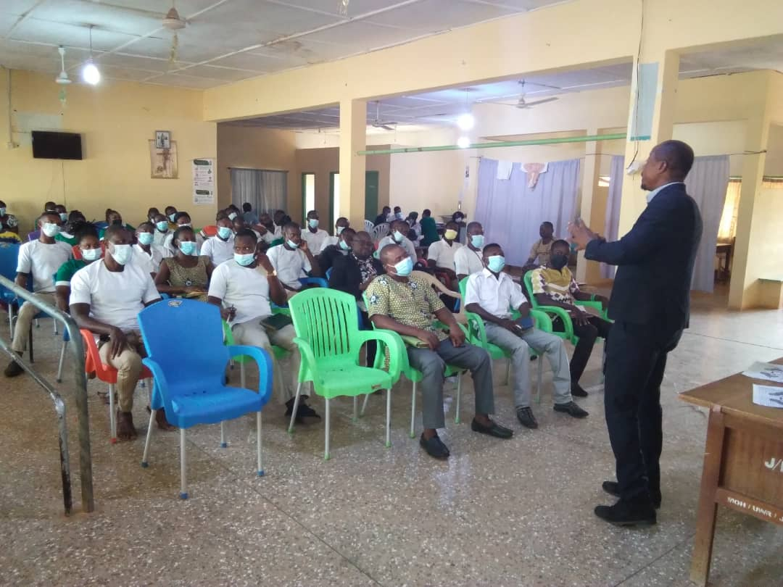
IN-SERVICE TRAINING

Slide 5
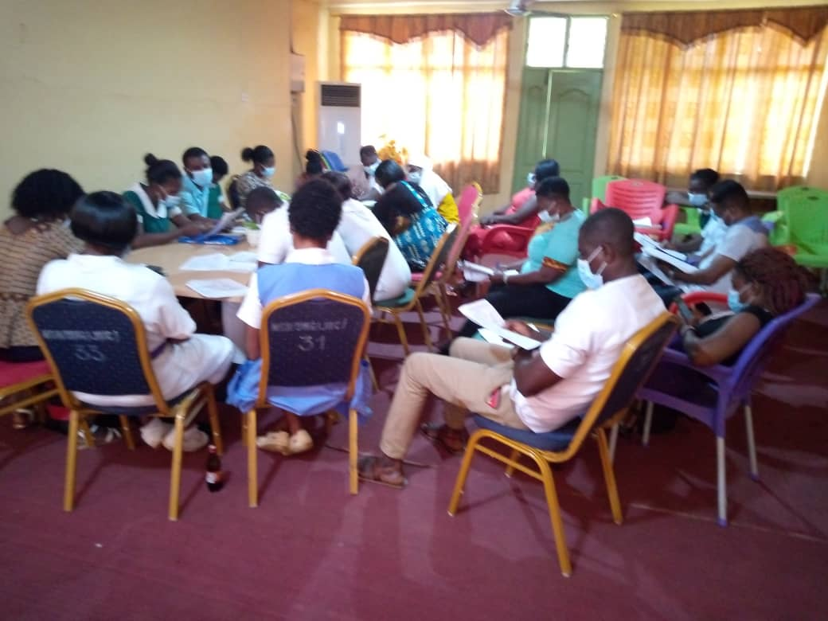
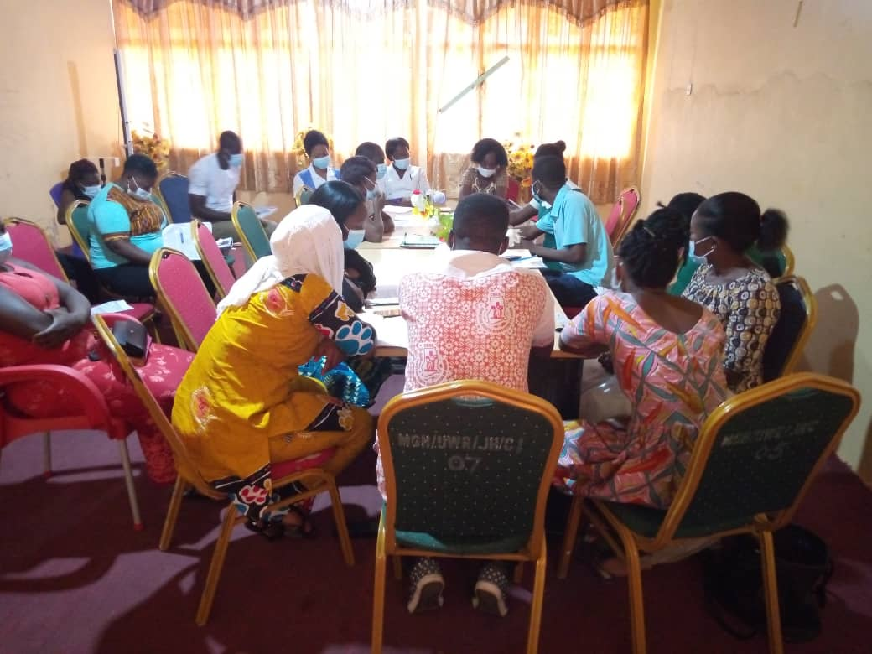
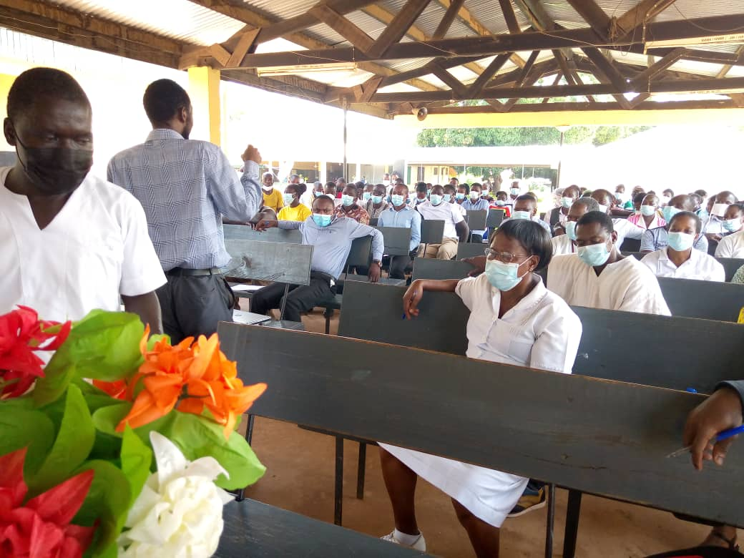
Durbars and Audit

Slide 6
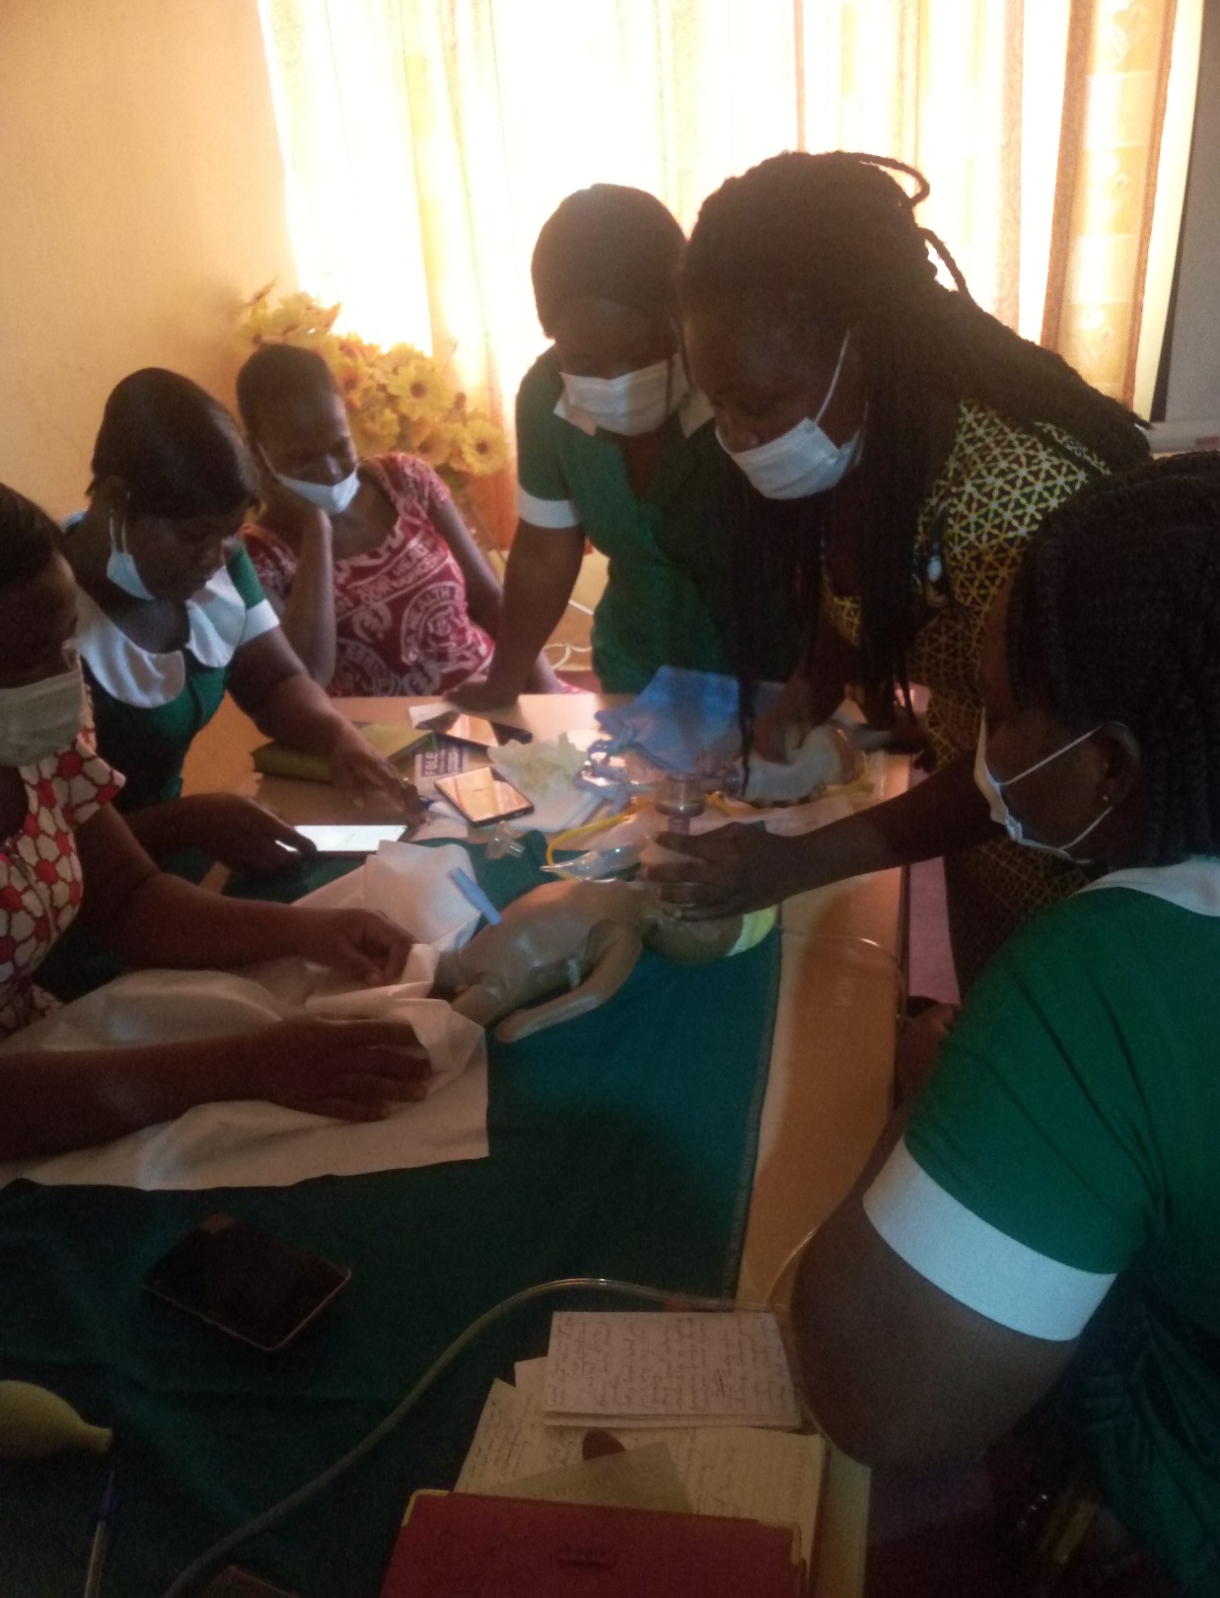
TRAINING ON NEONATAL RESUSCITATION

Slide 7
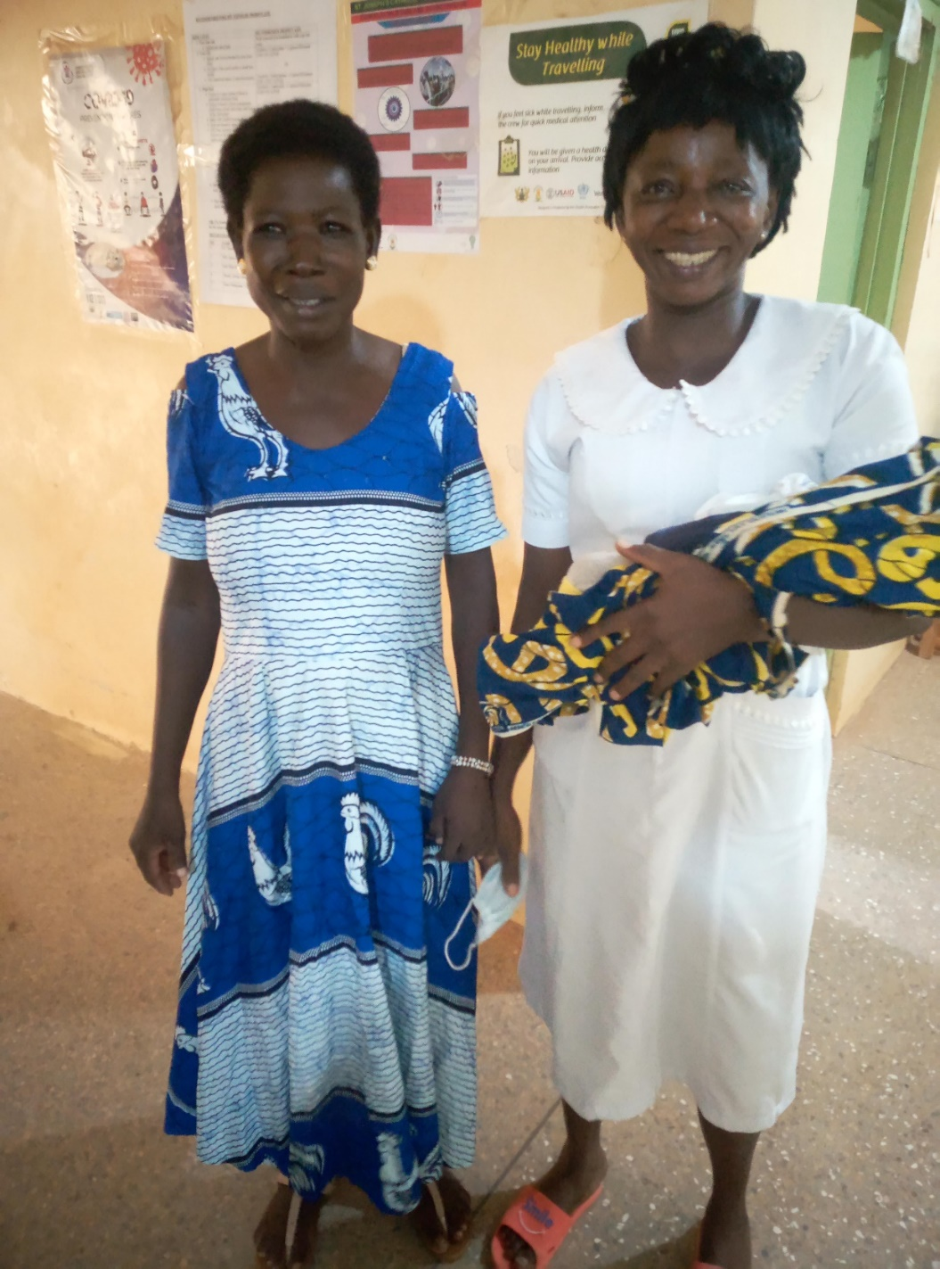
A NEAR-MISS CASE

Slide 8
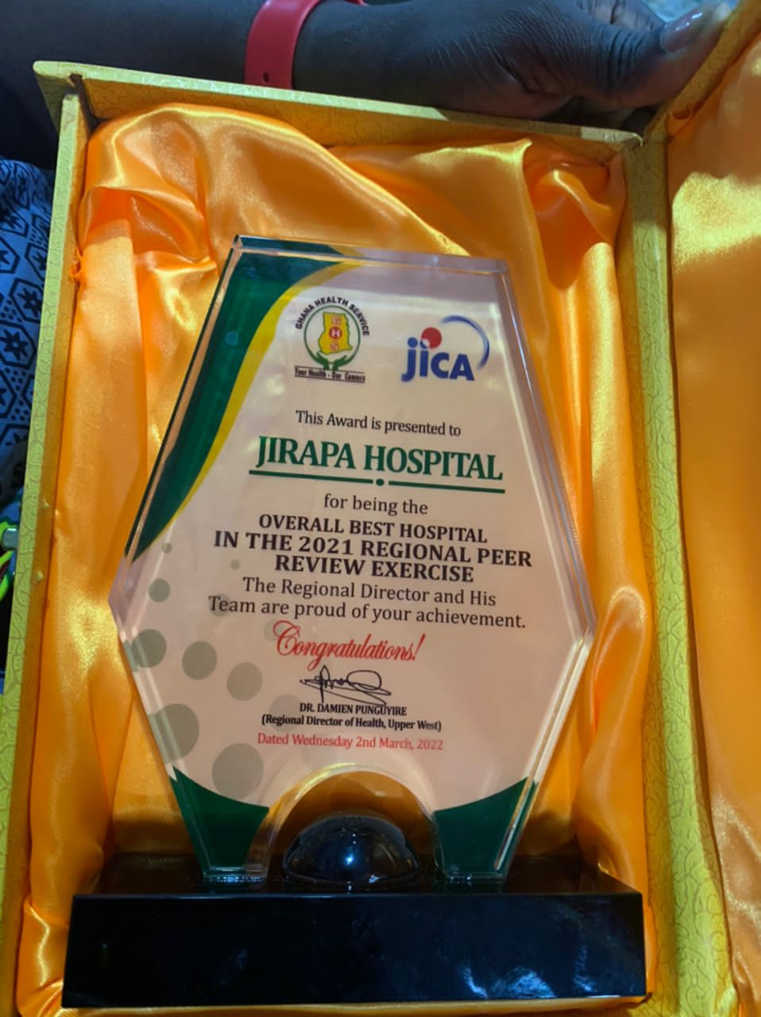

Slide 9
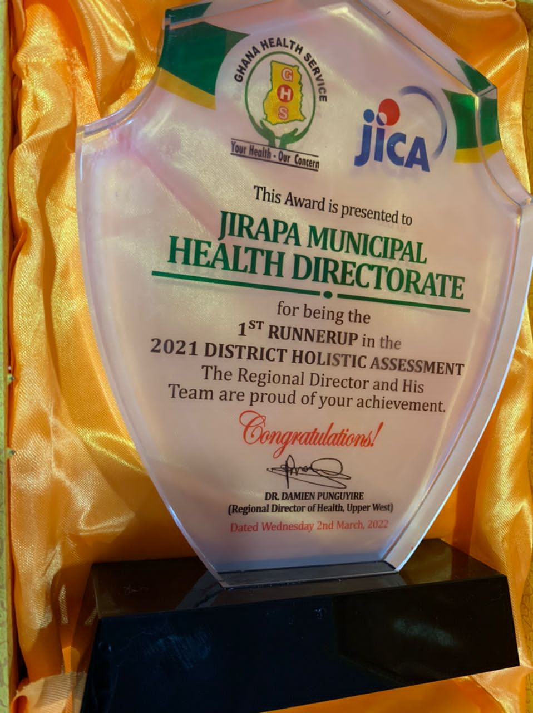

Slide 10
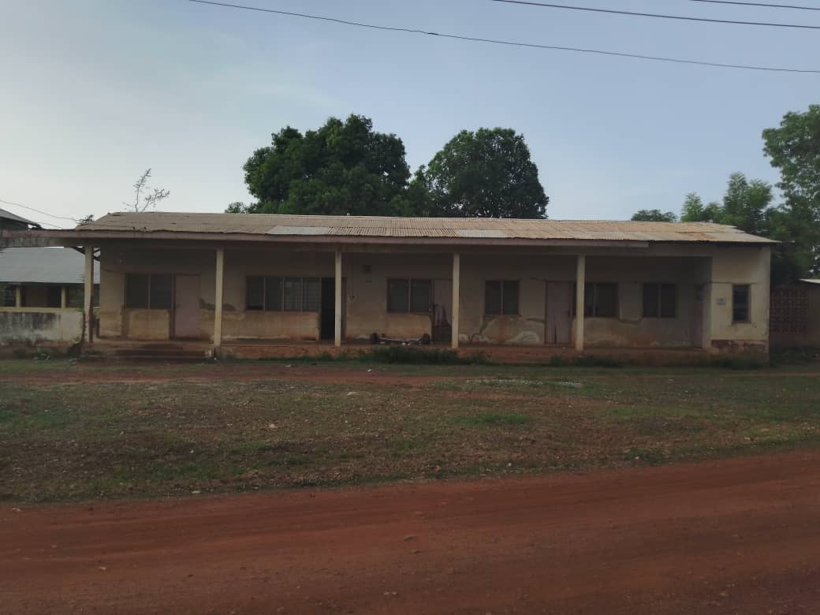

Slide 11
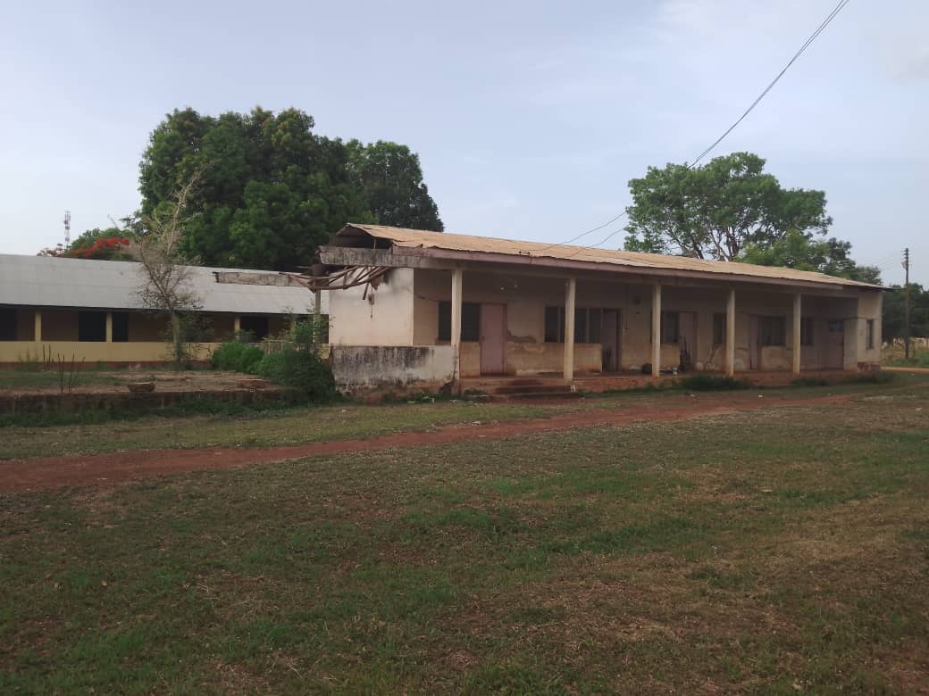

Slide 12
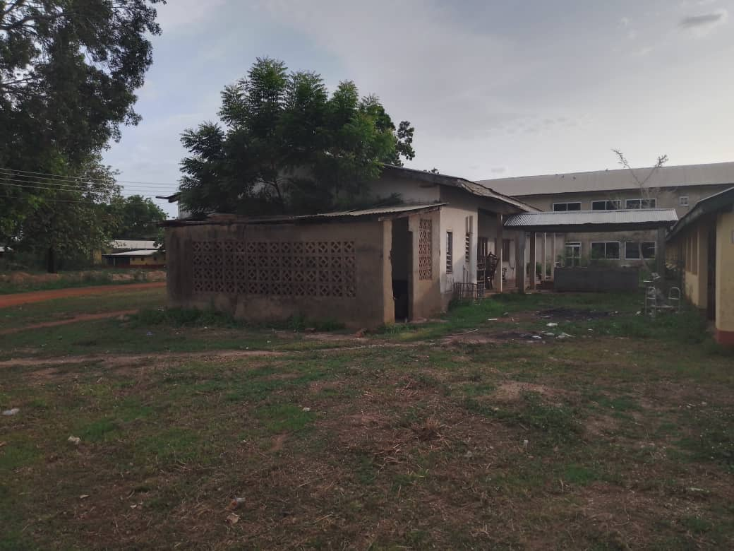

Slide 13
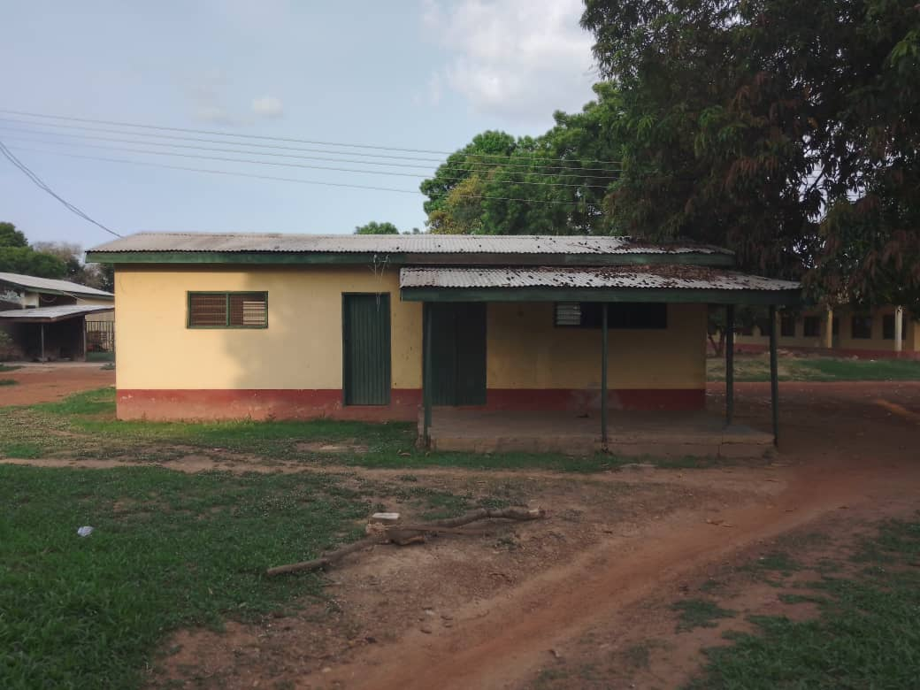

Slide 14
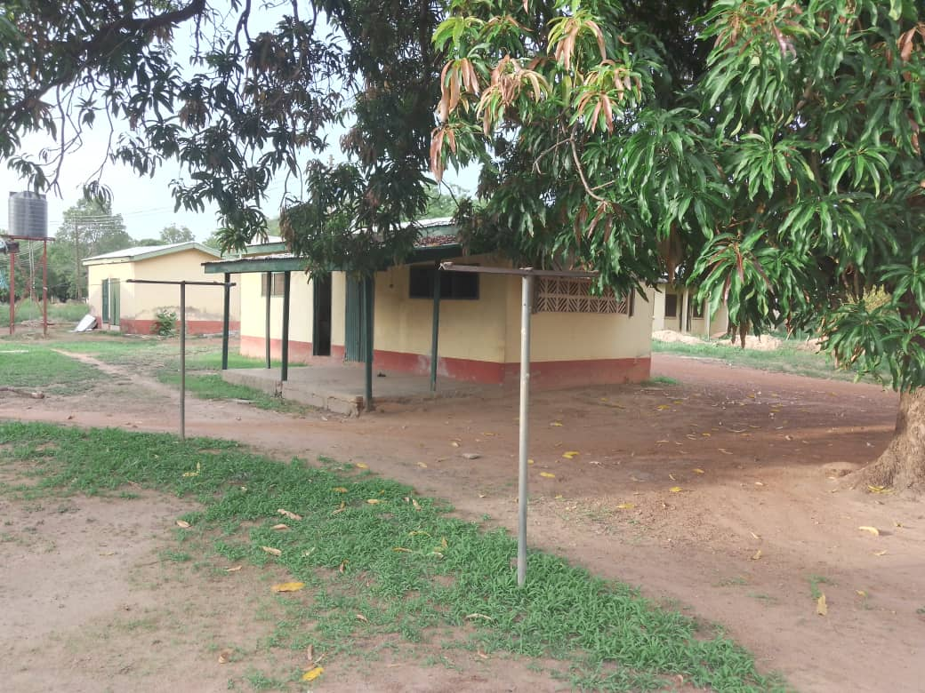

Slide 15
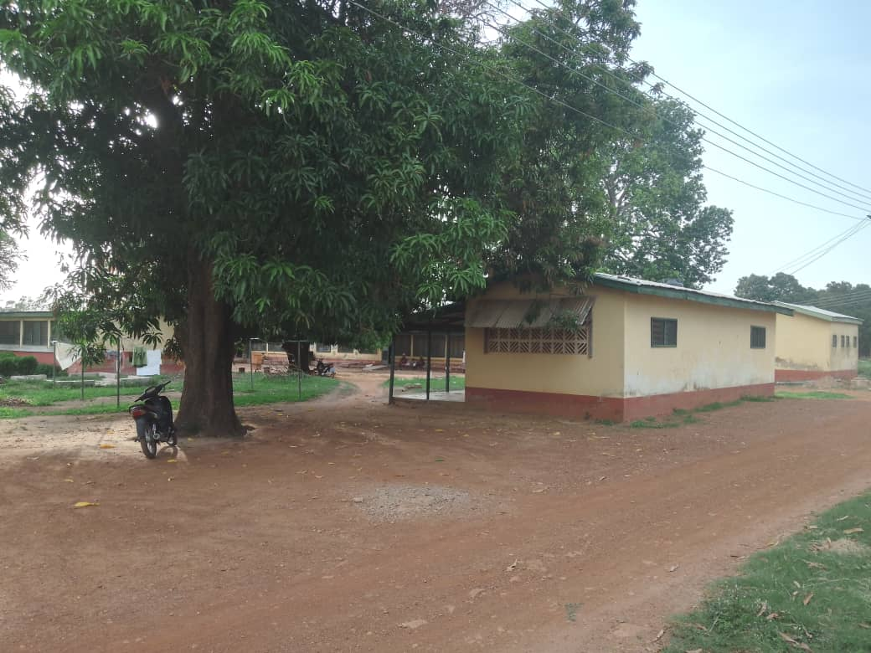

Slide 16
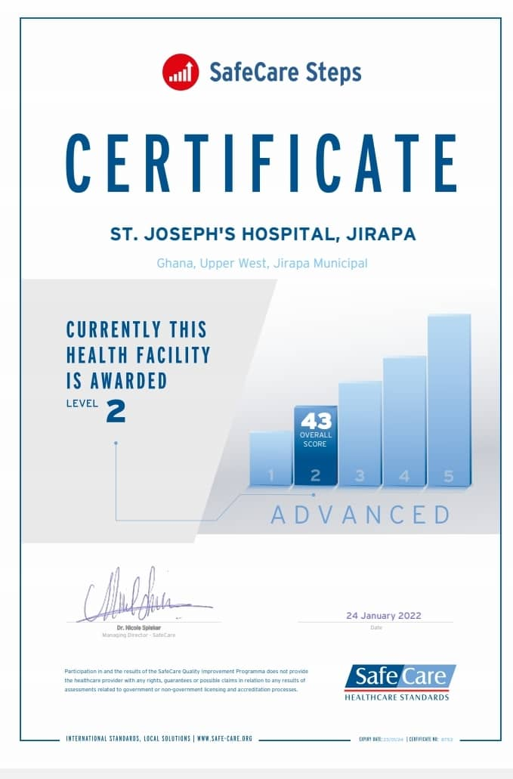

Slide 17
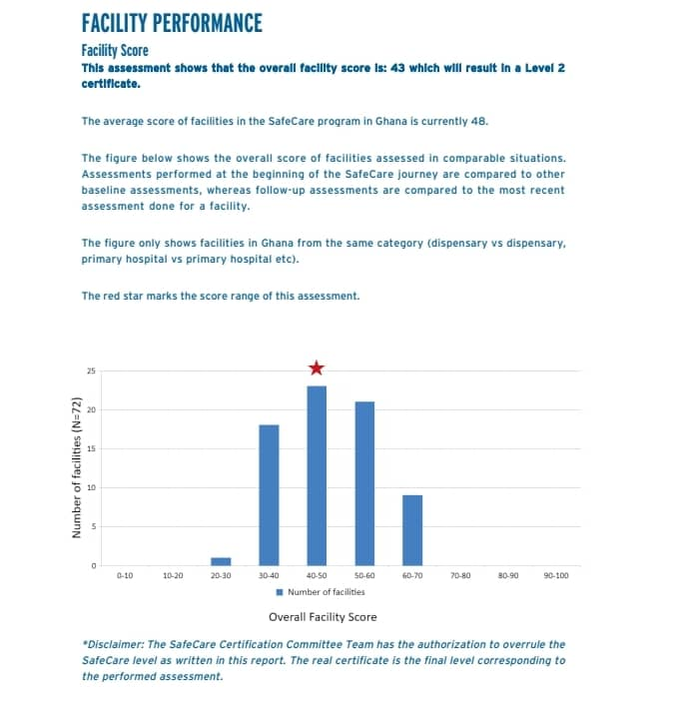

Slide 18
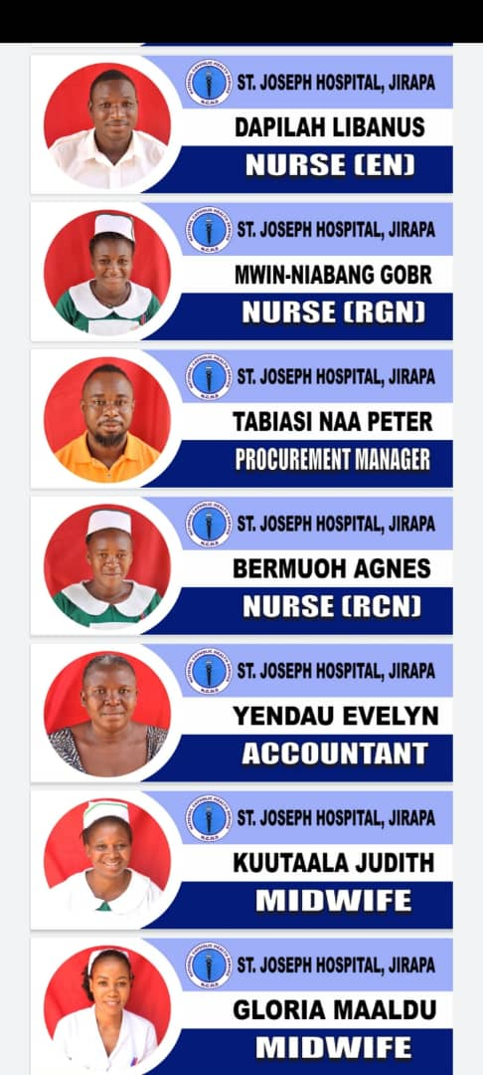
STAFF NAMETAGS

Slide 19

STAFF MEDICAL SUBSIDY

Slide 20
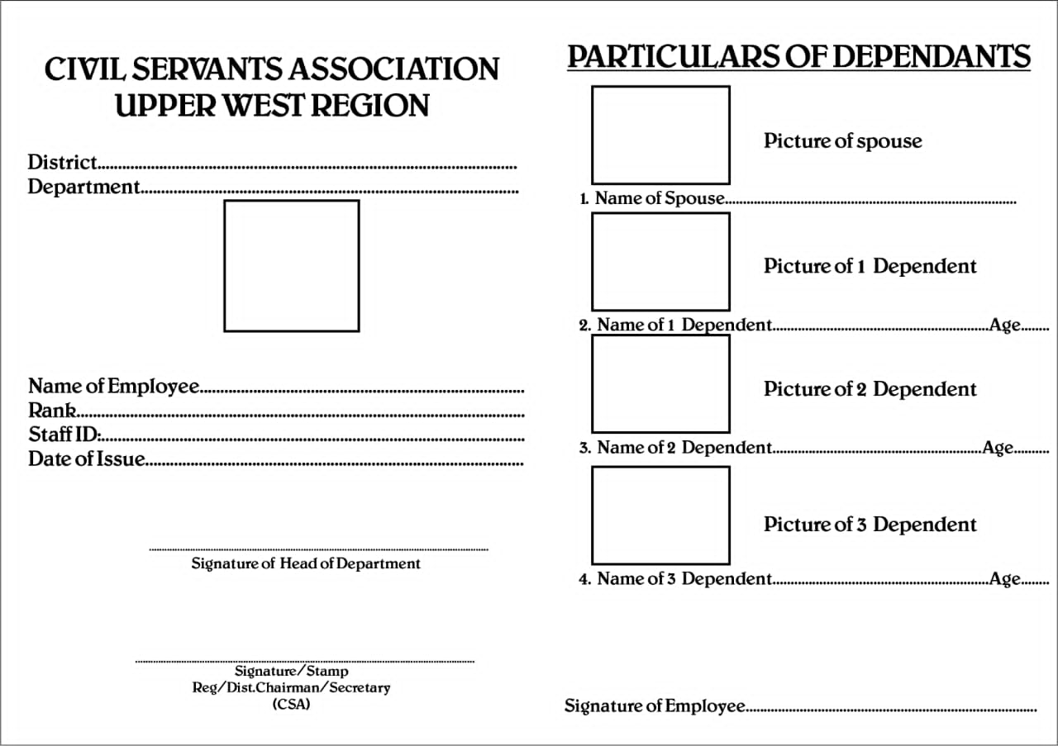

Slide 21
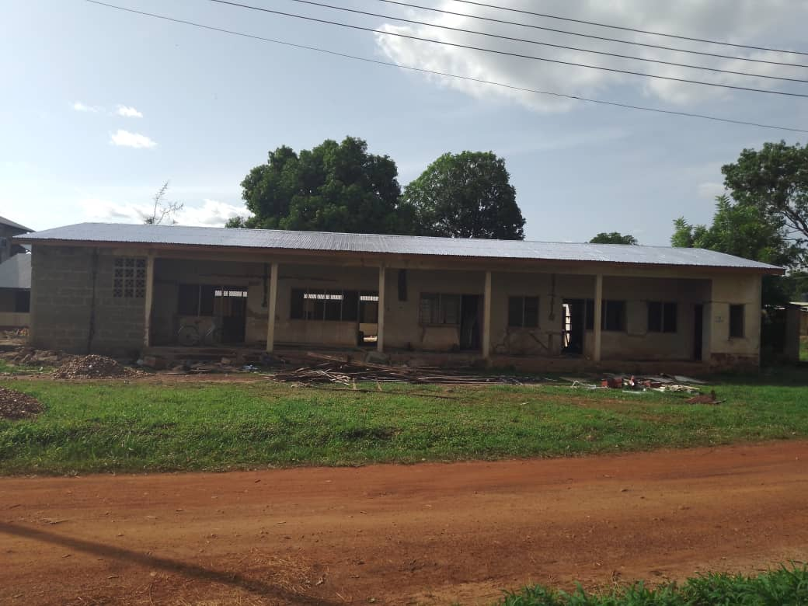

Slide 22
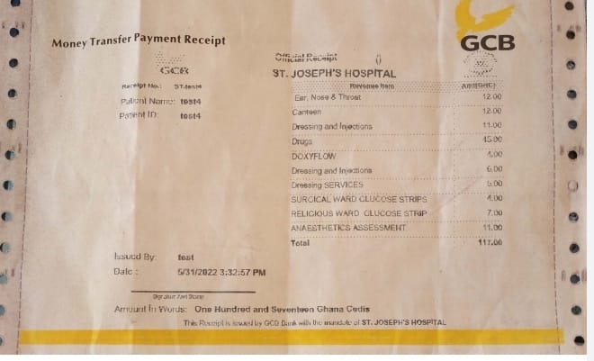
GCB – ONSITE + INTERNET BANKING

Slide 23
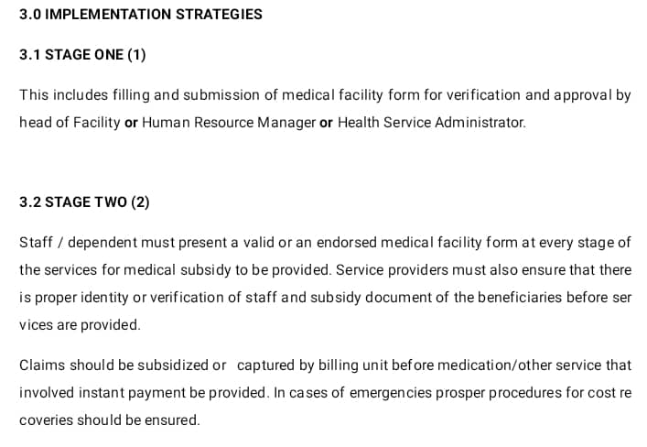

Slide 24
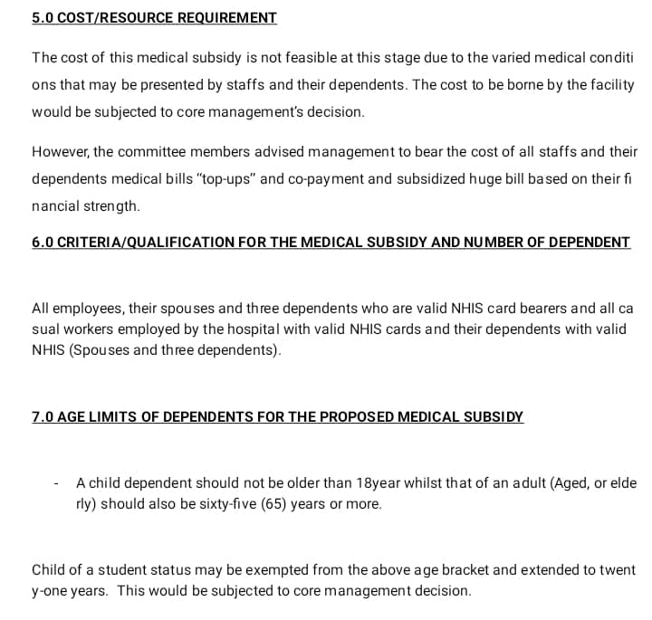

Slide 25
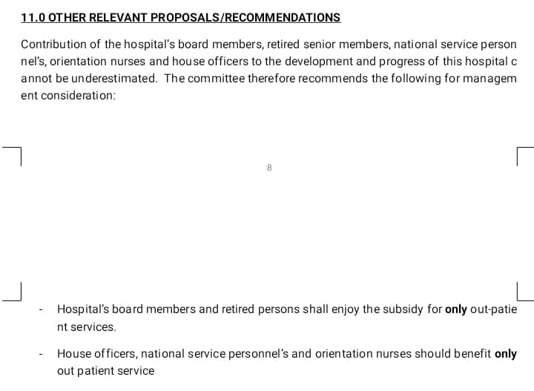

Slide 26
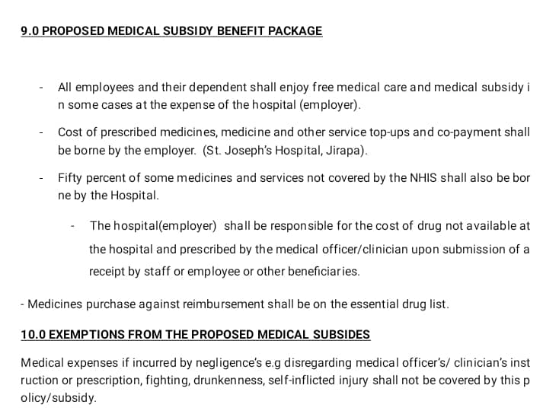

Slide 27
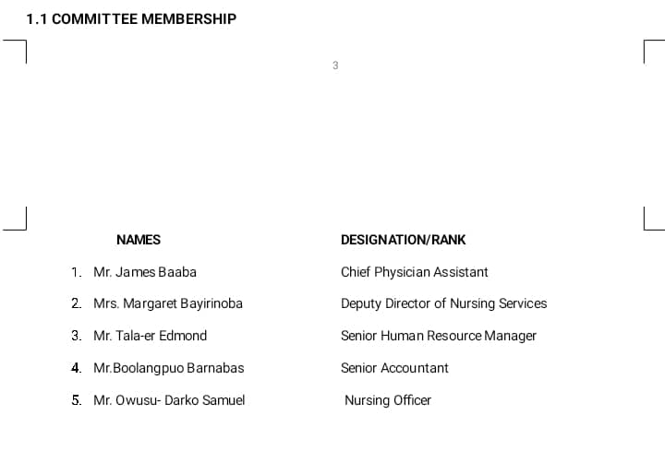

Slide 28
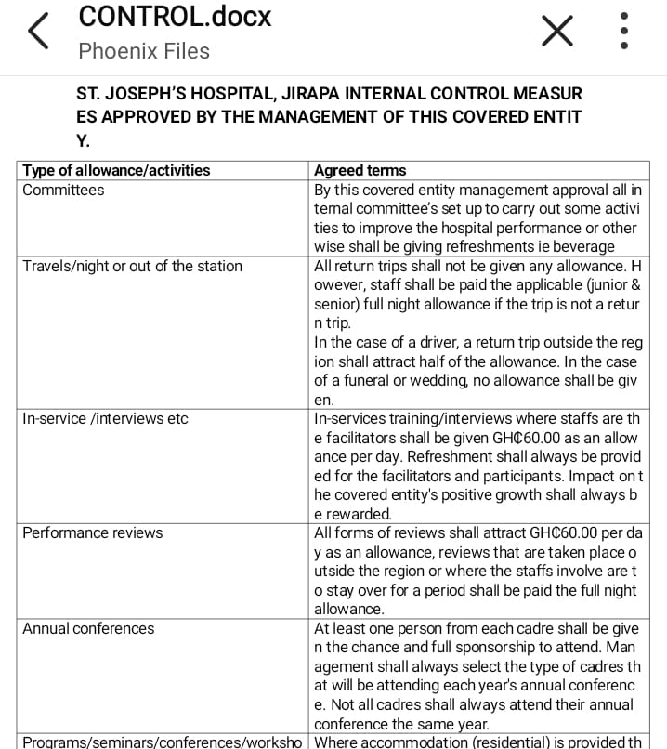

Slide 29
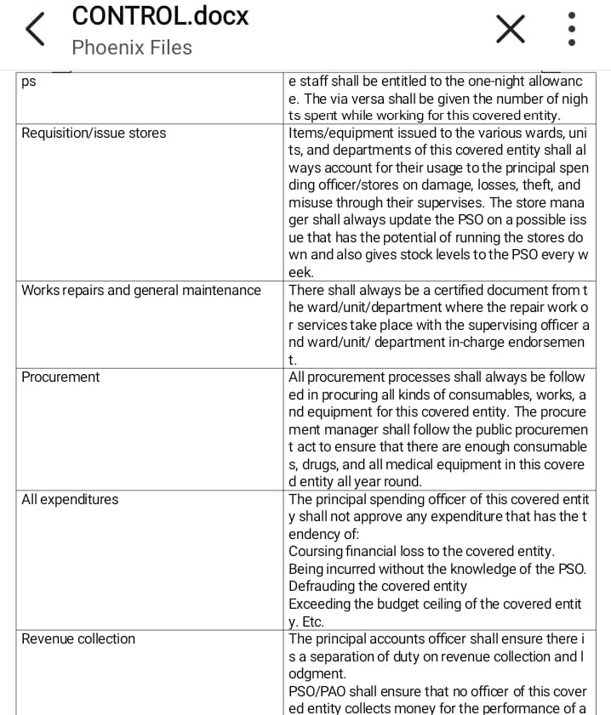

Slide 30
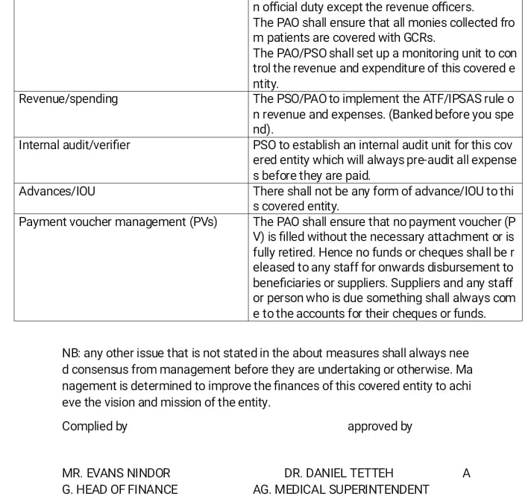

Slide 31
MATRON 360
Ward Checklist
1 | Punctuality
2 | Appearance of staff
3 | Staff identity (Name Tag On)
4 | Admission and orientation of Clients
5 | Maintenance of Vital Signs
6 | Maintenance of Treatment/Medication chart
7 | Procedures Adequately Explained to Patients
8 | Management of Emergency Medicines
9 | Availability of essential equipment e.g Thermometers, Suction Machine, Oxygen, B/P Apparatus
10 | Neatness of the Ward
11 | Ward Meetings/Welfare
12 | Handing over & Taking Over of the Ward
13 | Monthly Duty Roster e.g Any Alterations made
14 | Status of Toilet, Bathrooms and the Sluice Room
15 | Special initiatives e.g Bedbathing, Feeding, Bedmaking, Treatment of Pressure Areas
16 | Information dessemination/Protocols
17 | Universal Precaution: Hand washing
18 | Documentation at the Ward
19 | Handing over of patients to CHN for follow-up/Review
20 | Submission of timely Monthly Reports

Slide 32
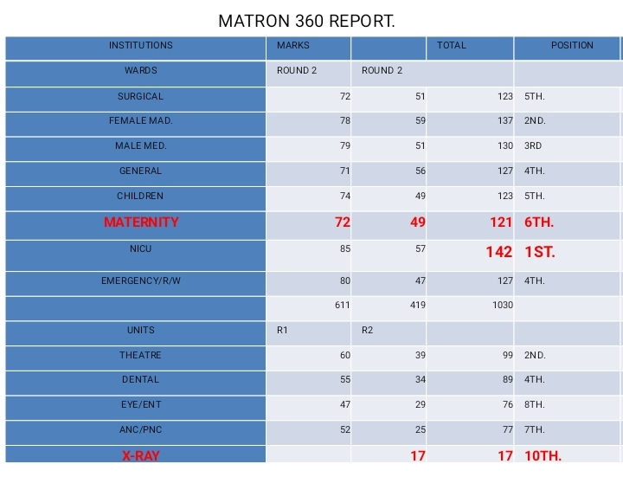

Slide 33
MATRON 360 REPORT
WARDS | MARKS | PERCENT | POSITION | UNITS | MARKS | PERCENT | POSITION | DEPARTMENT | MARKS | PERCENT | POSITION
SURGICAL | 72 | 72% | 6 | THEATRE | 60 | 60% | 2 | ADMINISTRATION | 45 | 45% | 2
FEMALE MAD. | 78 | 78% | 4 | DENTAL | 55 | 55% | 5 | RECORDS | 50 | 50% | 1
MALE MED. | 79 | 79% | 3 | EYE/ENT | 47 | 47% | 9 | STORES |  | 0% | #N/A
GENERAL | 71 | 71% | 8 | ANC | 52 | 52% | 6 | PHARMACY | 44 | 44% | 3
 |  | 0% | #N/A | X-RAY |  | 0% | #N/A | SECURITY | 32 | 32% | 5
CHILDREN | 74 | 74% | 5 | LABORATORY | 52 | 52% | 6 | KITCHEN | 33 | 33% | 4
MATERNITY | 72 | 72% | 6 | PHU | 52 | 52% | 6 | CRETCH
NICU | 85 | 85% | 1 | OPD | 64 | 64% | 1 | MORTUARY
EMERGENCY | 80 | 80% | 2 | VCT | 57 | 57% | 4
 |  |  |  | PHYSIO/MENTAL | 58 | 58% | 3

Slide 34
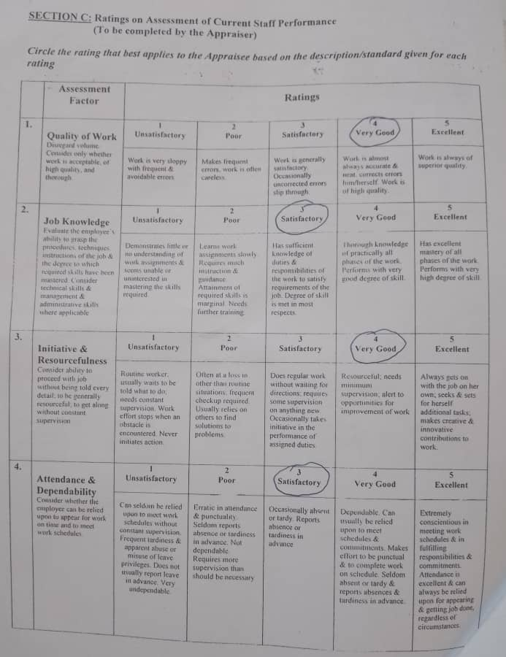
KEY PERFORMANCE INDICATORS

Slide 35
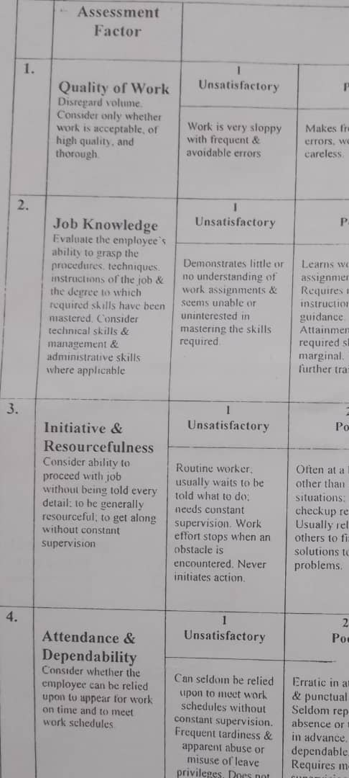

Slide 36
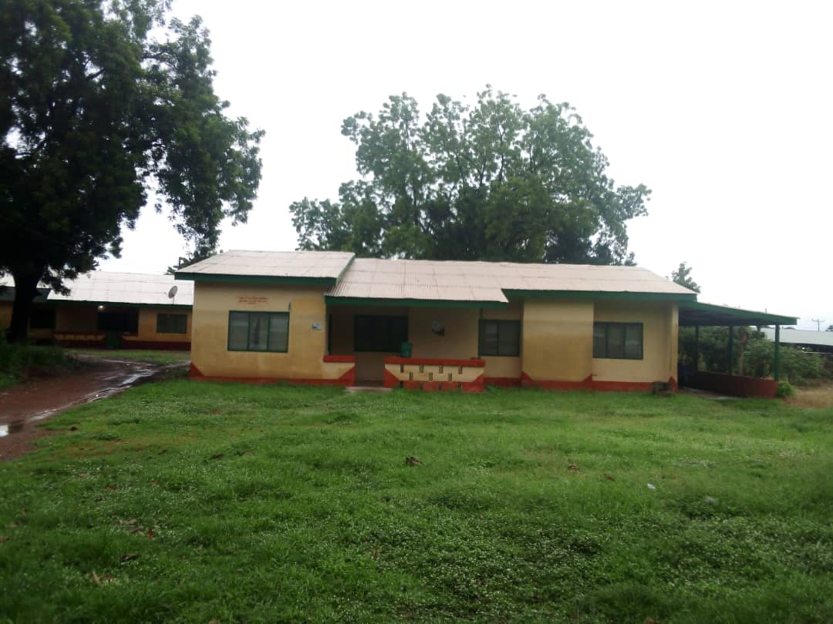

Slide 37
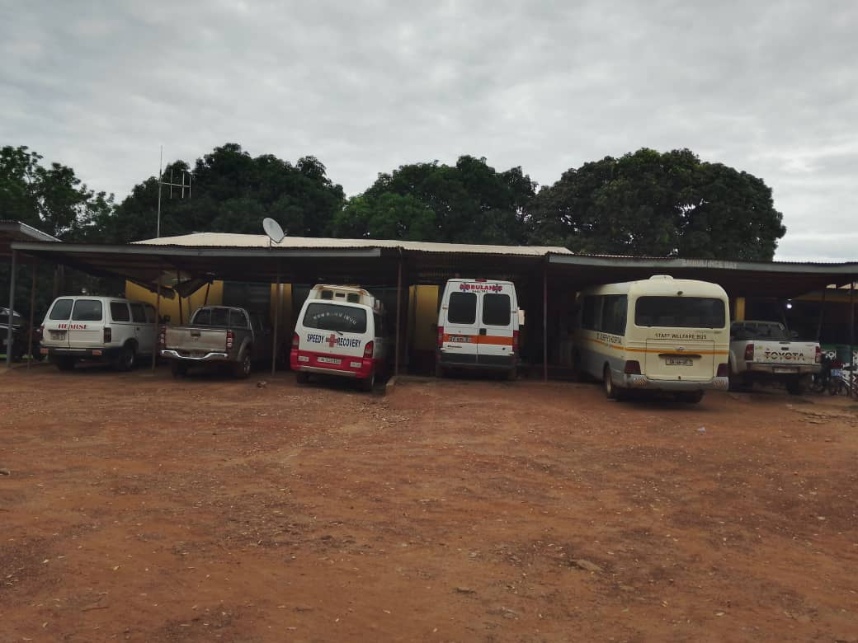

Slide 38
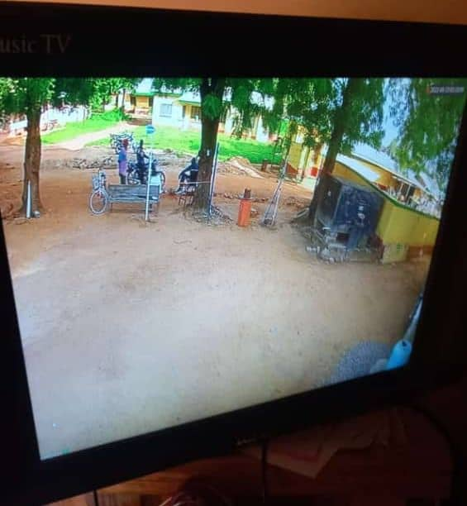

Slide 39
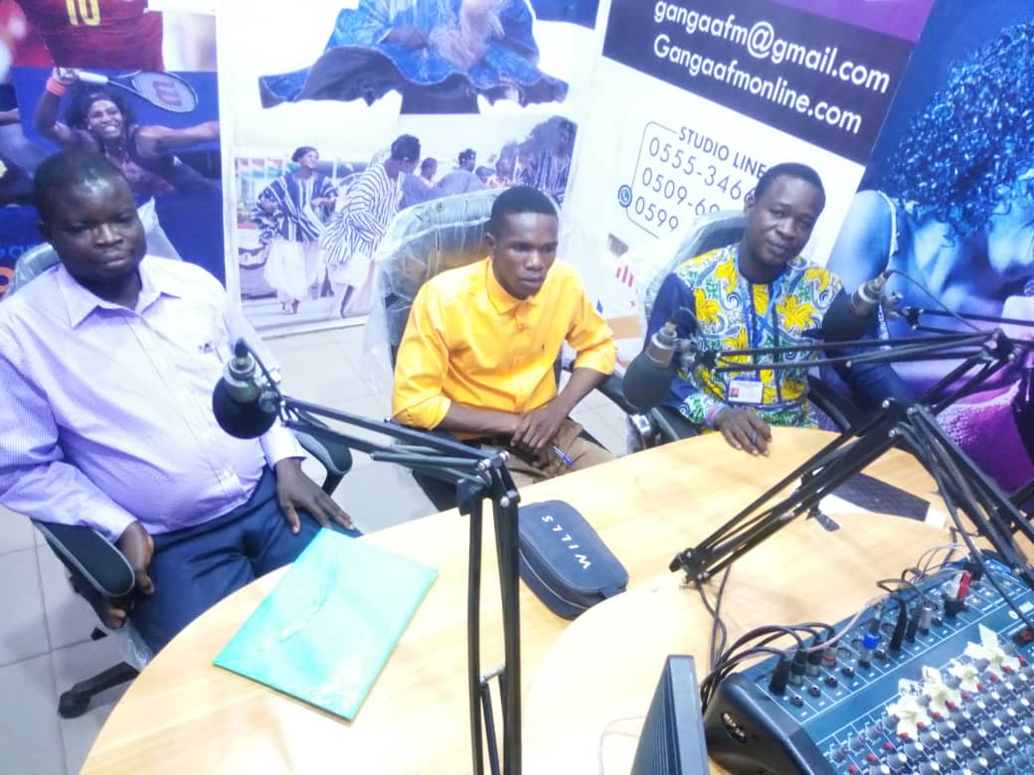

Slide 40
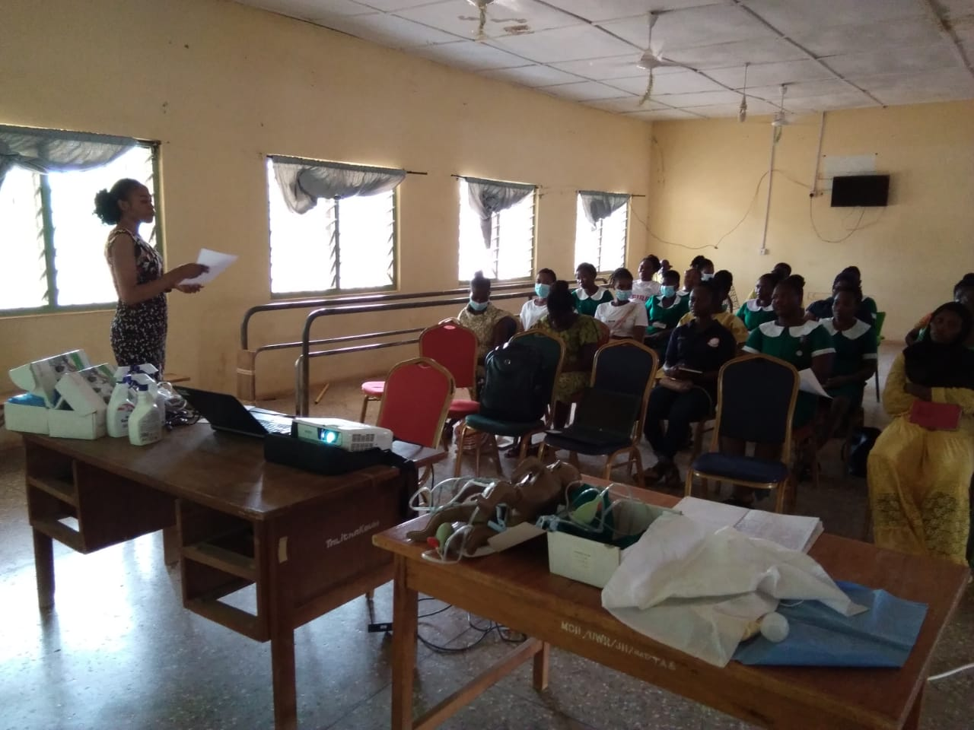
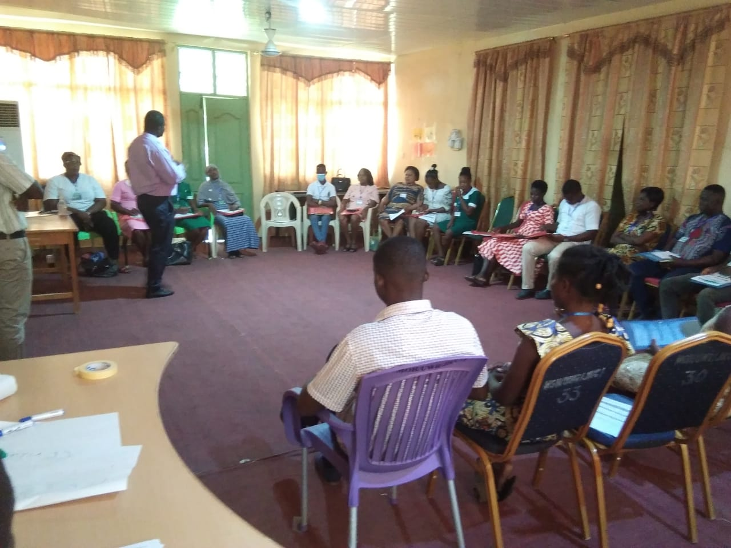

Slide 41
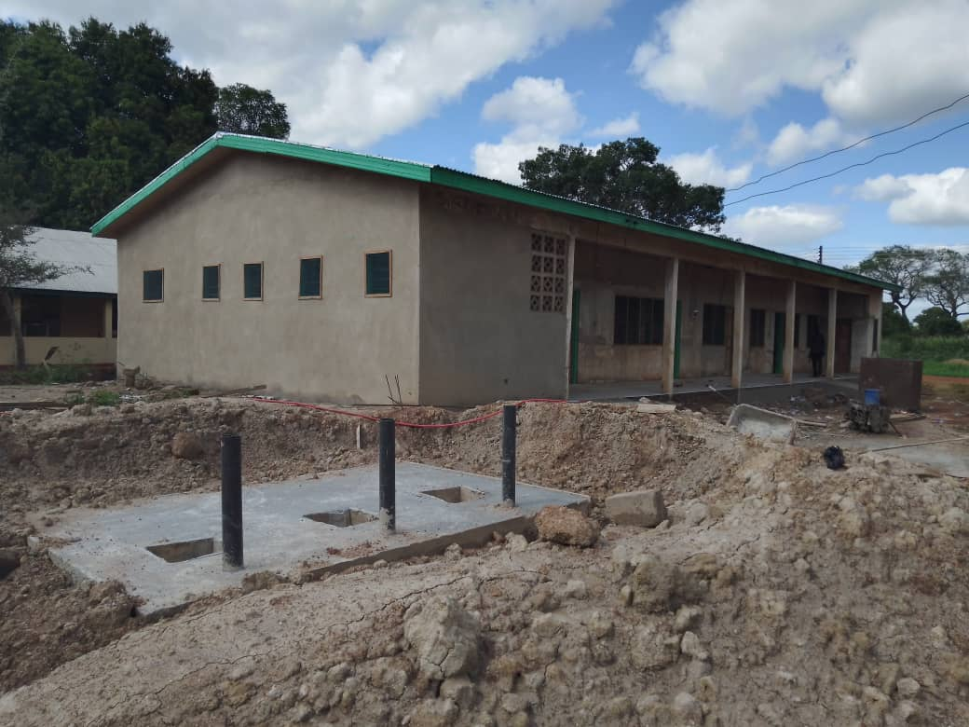

Slide 42
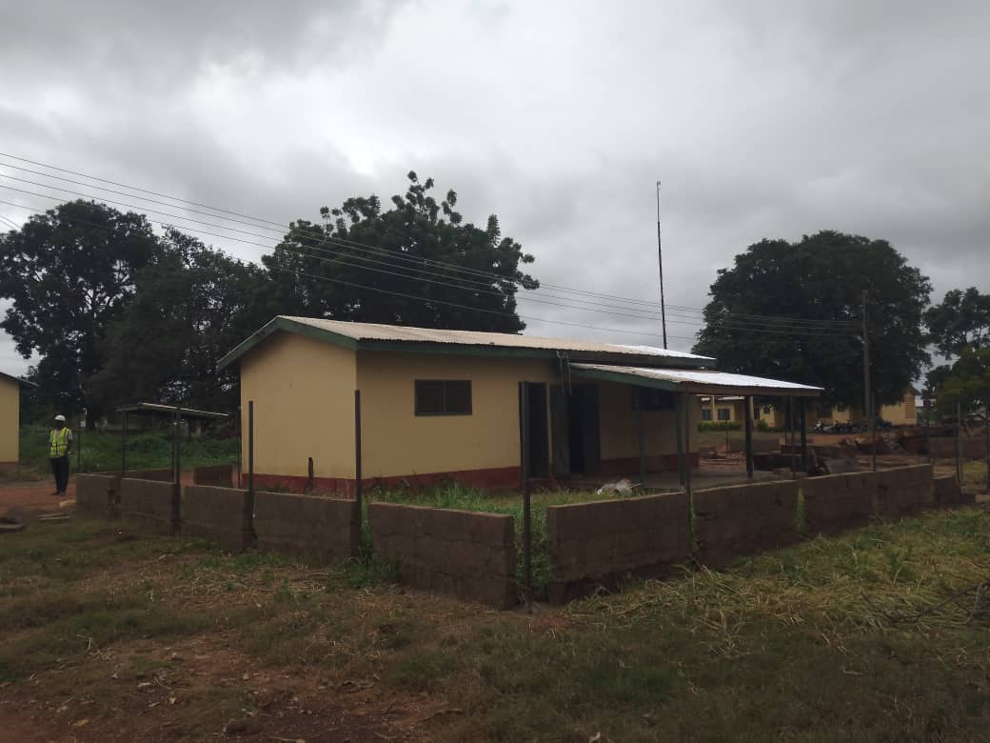

Slide 43
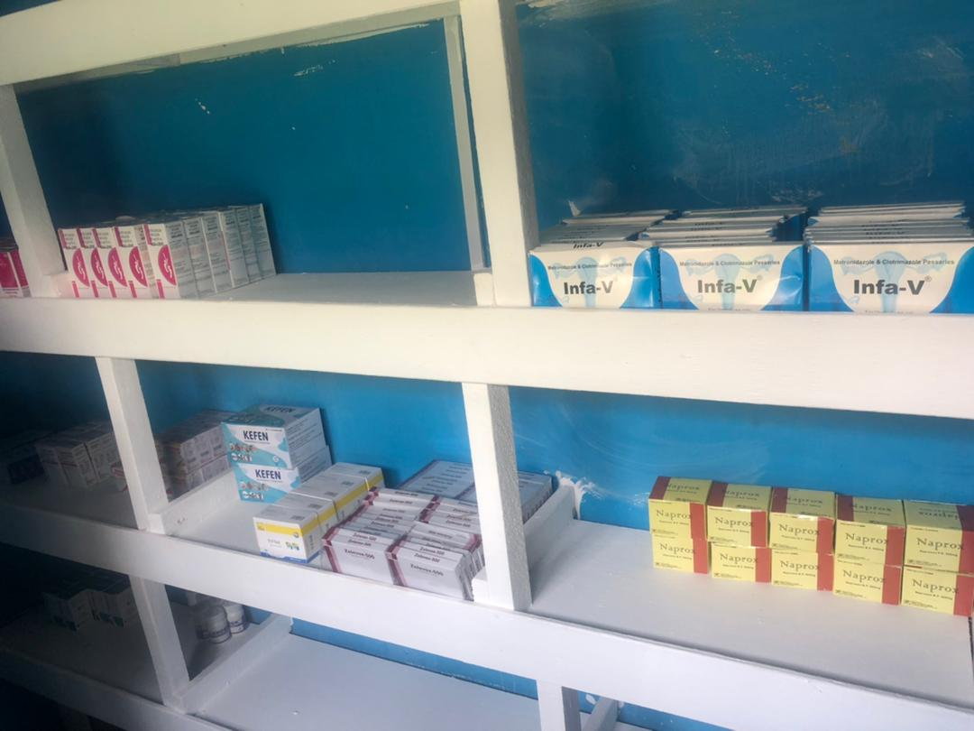

Slide 44
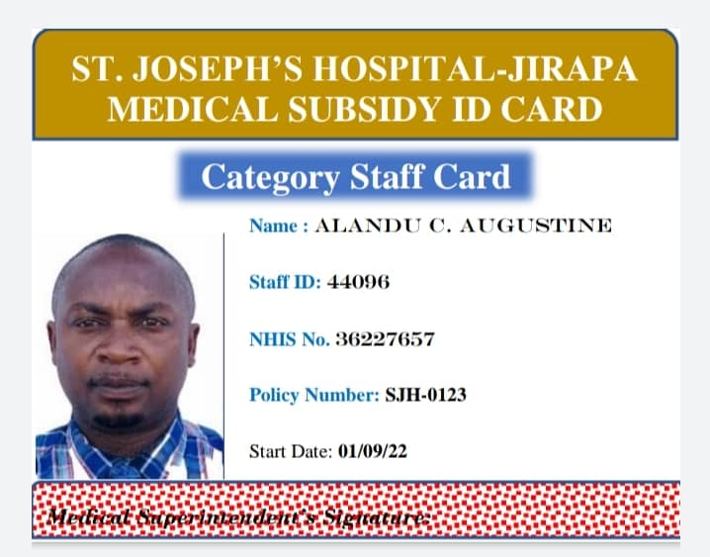

Slide 45
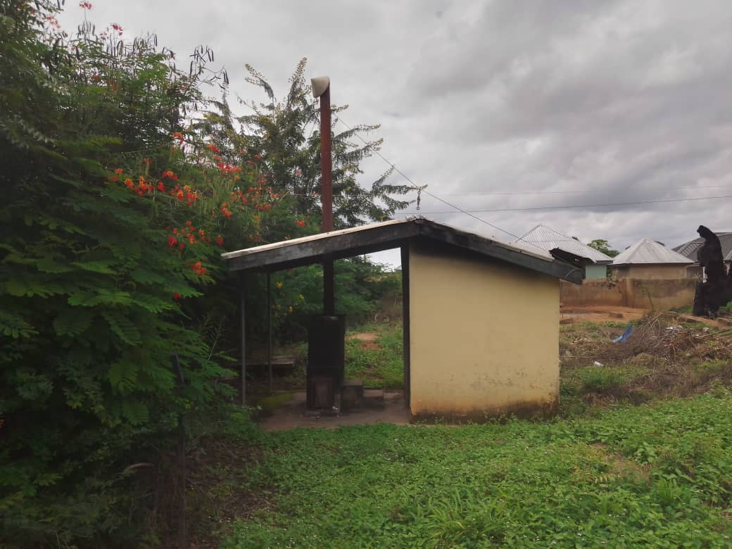
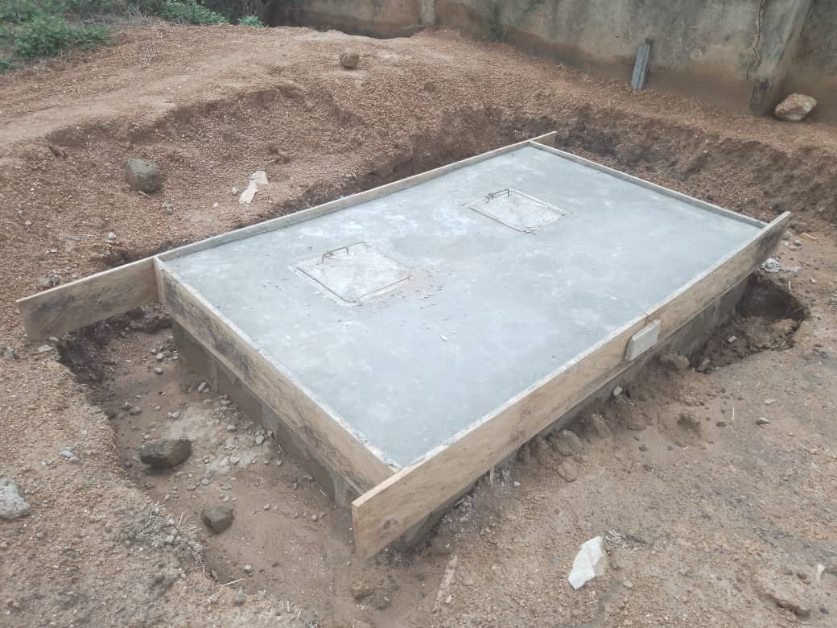
INCINERATOR

Slide 46
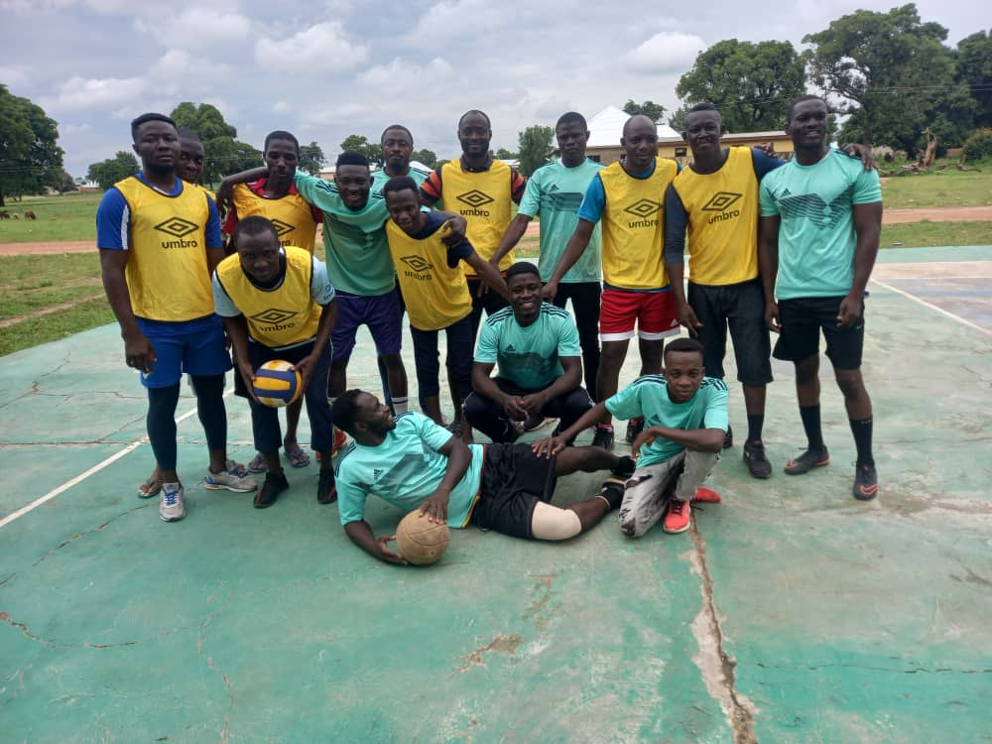
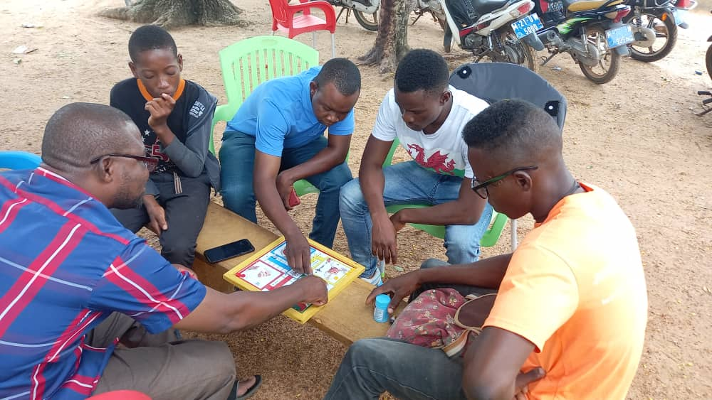
FUN GAMES

Slide 47
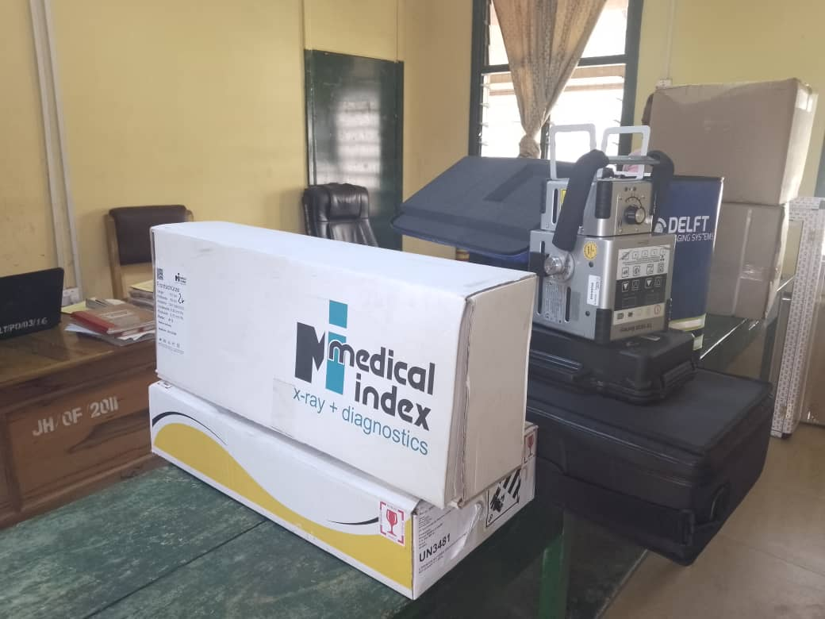

Slide 48






BLOOD DONATION SESSIONS

Slide 49


MORTUARY EXIT

Slide 50

RENOVATION AND MINOR MAINTENANCE

Slide 51


Slide 52


Slide 53


IPD PHARMACY

Slide 54

STAFF NAMETAGS

Slide 55


Slide 56


Slide 57


Slide 58


HOSPITAL ROAD AND GUTTER CONSTRUCTION/ DILAPITATED HOSPITAL BUNGALOW

Slide 59


GOING THE EXTRA MILE

Slide 60

OVERALL BEST NURSE UPPER WEST REGION 2022

Slide 61

NEW HAEMATOLOGY ANALYSER
CCTV EXTENSION TO HOSPITAL ENTRANCE

Slide 62

DONATION FROM GHANA ANAESTHETISTS ASSOCIATION TO CHILDREN’S WARD

Slide 63

MOBILE DIGITAL X-RAY EQUIPMENT: DELFT LIGHT SOLUTION/NATIONAL TB PROGRAM

Slide 64

PRE-OPERATION ROOM AT THEATRE

Slide 65


GERMAN UROLOGISTS’ VISIT

Slide 66


GREATER WORKS RESTORATION FOUNDATION – SURGICAL TEAM VISIT

Slide 67


RENOVATED HOSPITAL BUNGALOW

Slide 68

DONATION FROM THE OFFICE OF THE MP FOR JIRAPA – HON. CLETUS DAPILAH

Slide 69


ROTARY CLUB CANADA VISIT AND DONATION

Slide 70


END OF YEAR STAFF AWARDS 2022
BEST LONG SERVING STAFF
RS. MARGARET BAYIRINOBA
BEST ADMINISTRATIVE STAFF – JUNIOR CATEGORY

Slide 71


END OF YEAR STAFF AWARDS 2022
OVERALL BEST STAFF
MRS. JANE-FRANCES AWAANA
BEST DEPARTMENT
MORTUARY DEPARTMENT

Slide 72


SECOND QUARTER 2022 BLOOD DONATION/COLLECTION EXERCISE

Slide 73

DRUG AND THERAPEUTICS COMMITTEE MEETING

Slide 74


THIRD QUARTER BLOOD DONATION EXERCISE

